Slide 1
Airline Reservation System
By: Team 3 / AirBook

Slide 2
Team Details
Name | PS Number
Aman Kumar Singh | 10671544
Khushi Mishra | 10671389
Arhan Das | 10671378
Mohit Agrawal | 10671552

Slide 3
Description
AirBook Flight Booking Portal serves the functionality of booking flight across various destination.
The front-end interface is designed using Angular 8, HTML 5, CSS, Bootstrap and Angular Material.
The back-end interface is designed using ASP.NET Web API, SQL Server Management Studio.
The website allows registration for new users and existing users can login into their account.
The website also allows admin login for admin who can add new flight and can also delete any existing flight.
The admin can also view the details of the users and flight details.
The project has been implemented using DB First approach.
The project take care of different modules like user module, admin module, flight search module and many more which are discussed later.
The application designed is user friendly and it becomes really easier for user to book their flights to travel to their destinations.

Slide 4
Objectives
A portal to search and book flights.
Enables user to select seat of their choice from the available seats.
Users can also select the class to travel in from the available two classes which are Economy class and Business class.
After successful booking and payment the users can also print the ticket which contains the details of their booking.
The service allows everyone to travel from source to their destination safely.

Slide 5
Scope
The Online Airline Reservation system has the following scope:
Airline Reservation System is one of the modifications that were carried out in the passenger Service so that the working and availability of Service can be broadened.
The system allows to carry out reservation on the desired airline from any place in India.
The system saves time as it allows online procedure as users no longer need to wait in long queue to book flights.
Admin is the main authority who can add, delete flights and can also view the user details.
With the help of this system, customers can view all the different flight’s availability with different timing for a particular date and it also allow them to reserve a seat and cancel a reservation.
Apart from the flight details, the user can login and view his/her booking history.
The user can print the ticket which contains the booking information.

Slide 6
Modules
Admin Module
Login
Add and Delete flights
User module
Register
Login
Flight Search
Flight Select
Passenger Details
Seat Select
Payment
Cancel Ticket
Flight Search
Flight Select

Slide 7
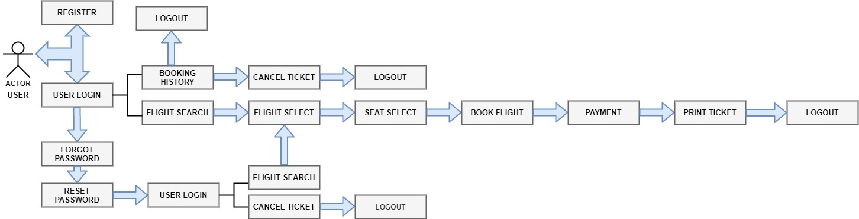
Application Flow (User)

Slide 8
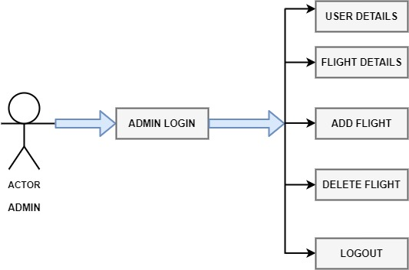
Application Flow (Admin)

Slide 9
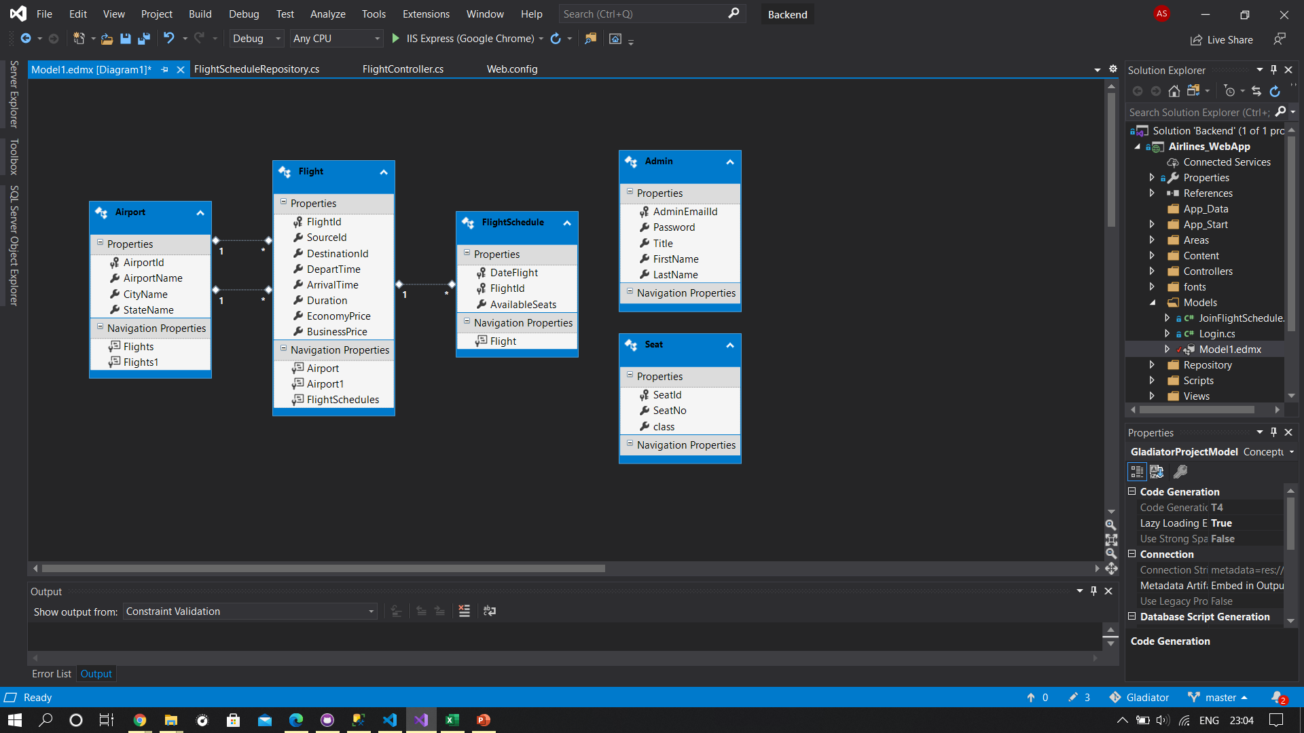
Database Design

Slide 10
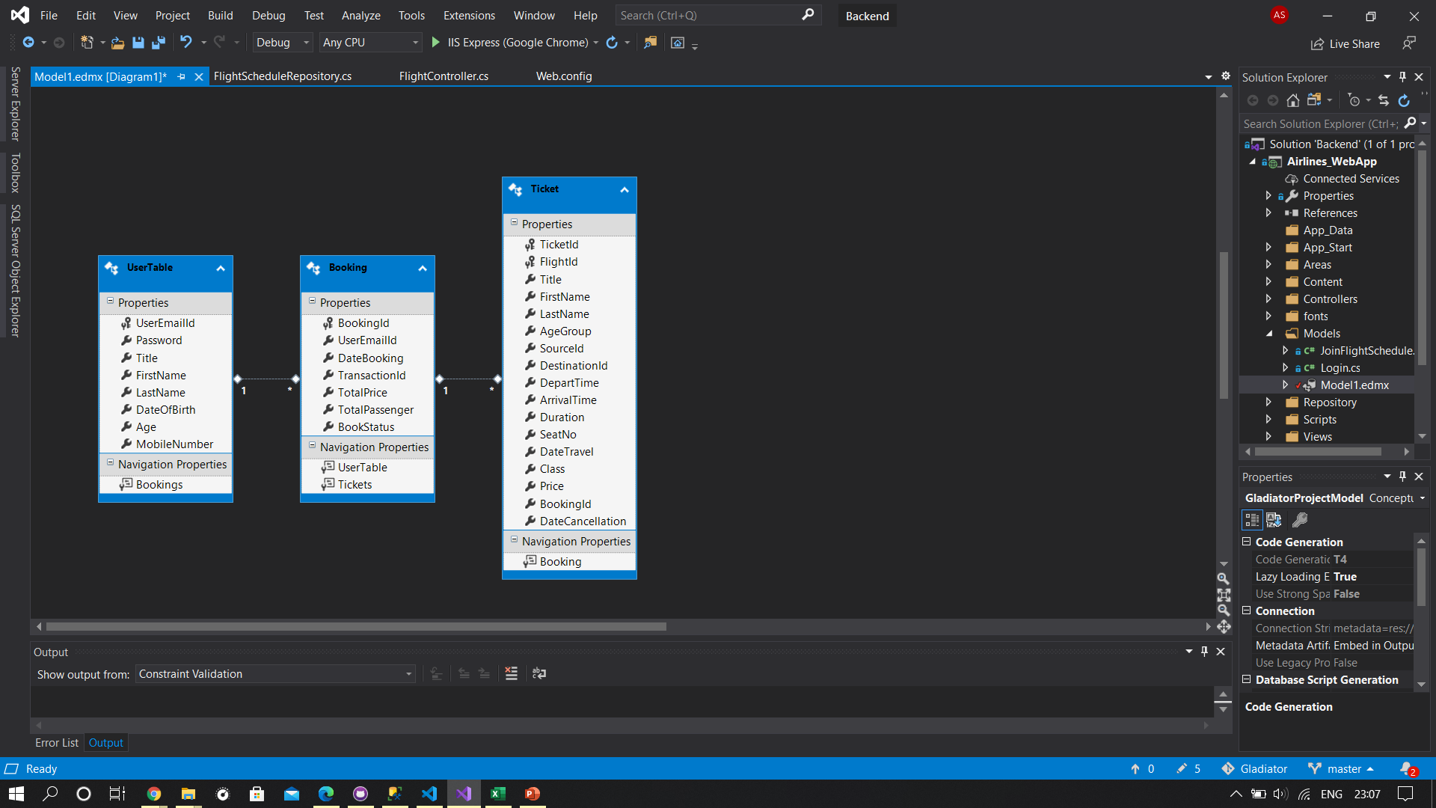
Database Design (Continued…)

Slide 11
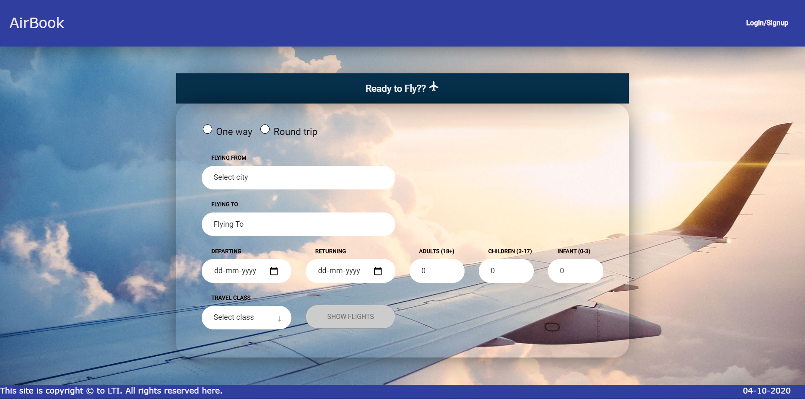
Home Page

Slide 12
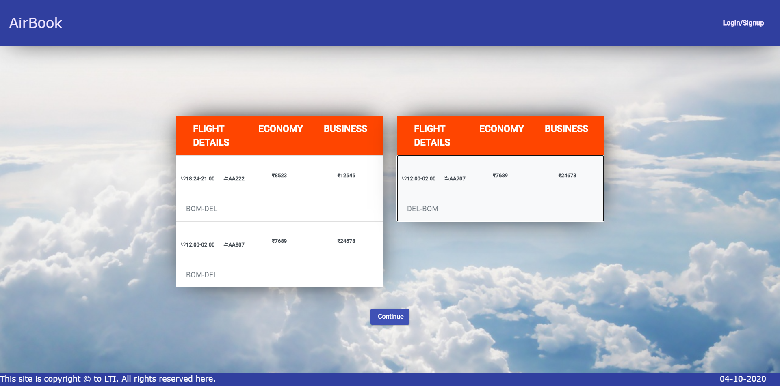
Flight Search Result

Slide 13
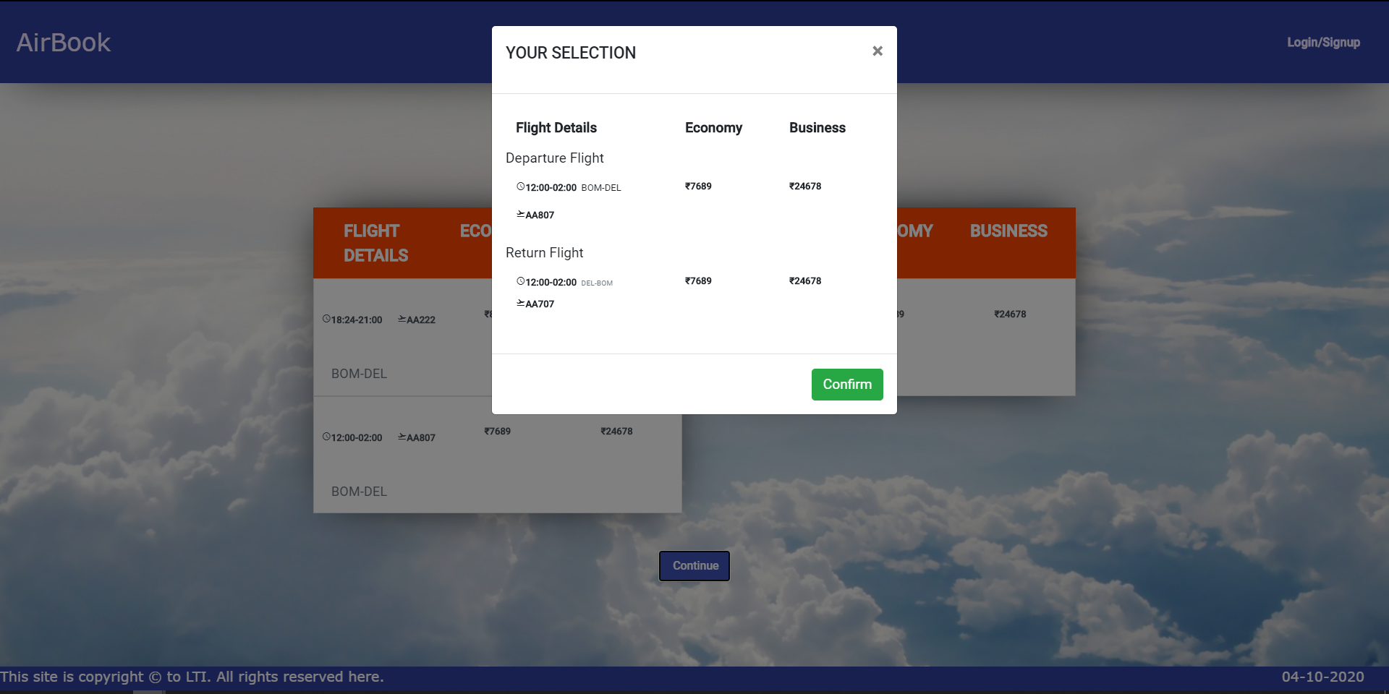
Confirm Selection

Slide 14
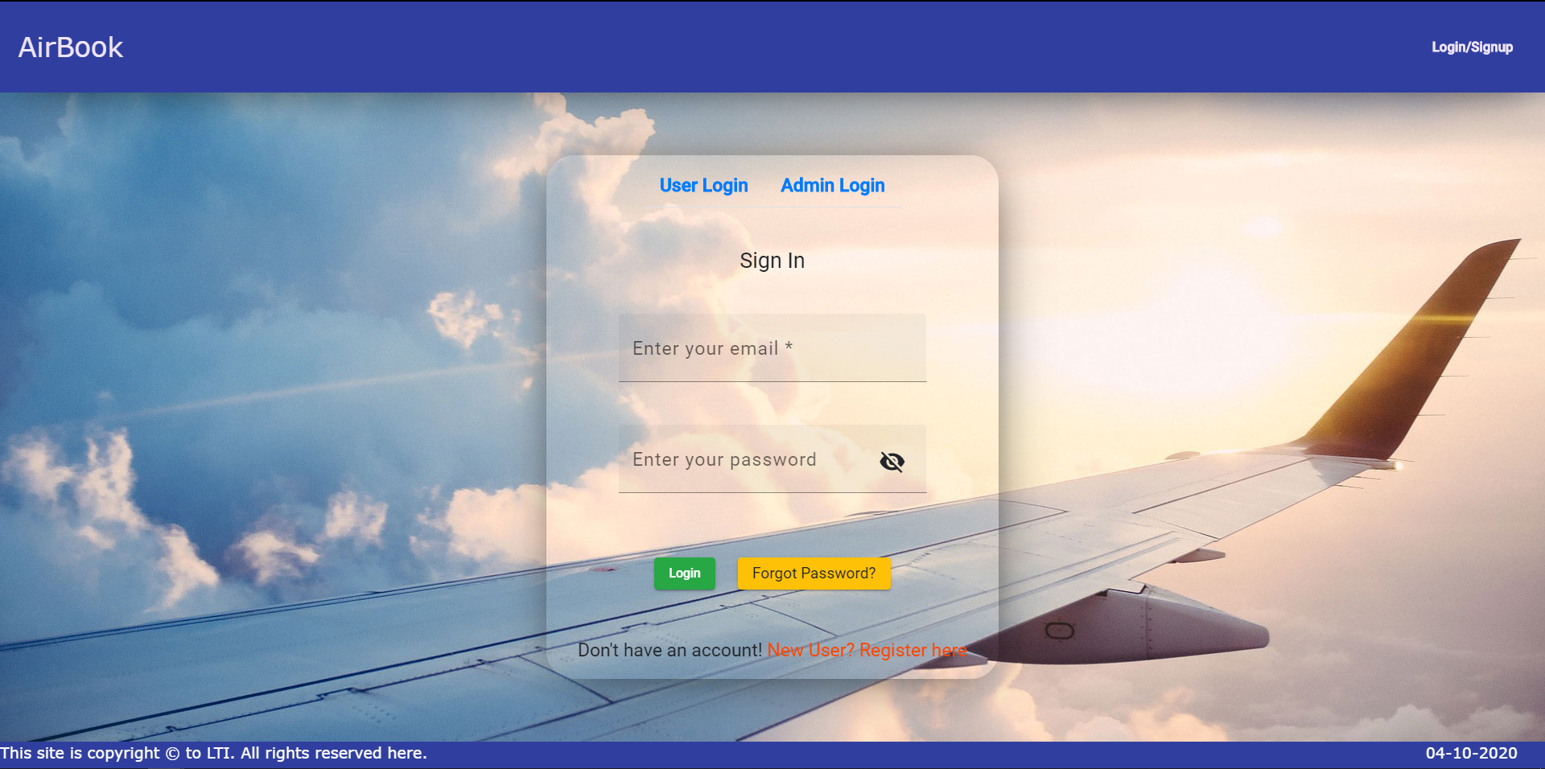
User Login

Slide 15
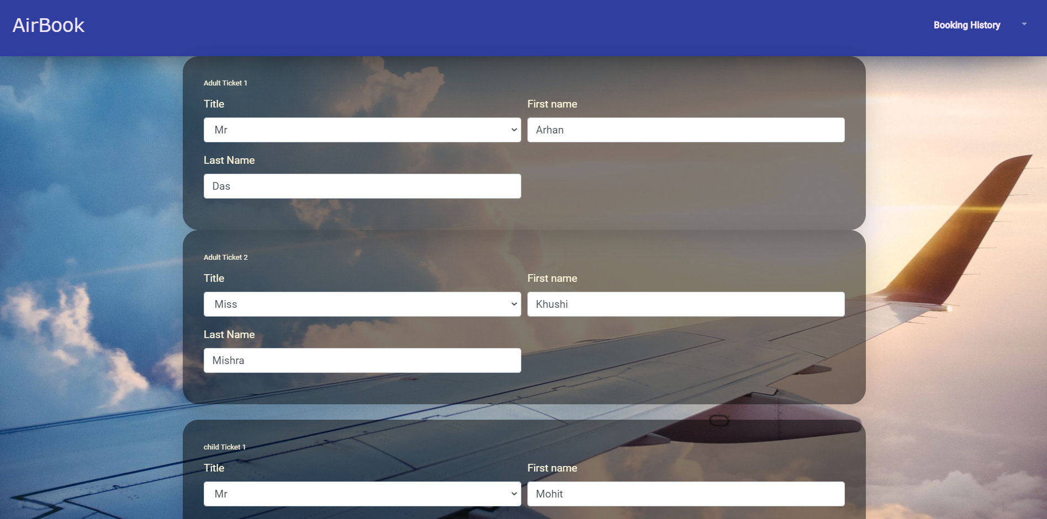
Enter Passenger Details

Slide 16
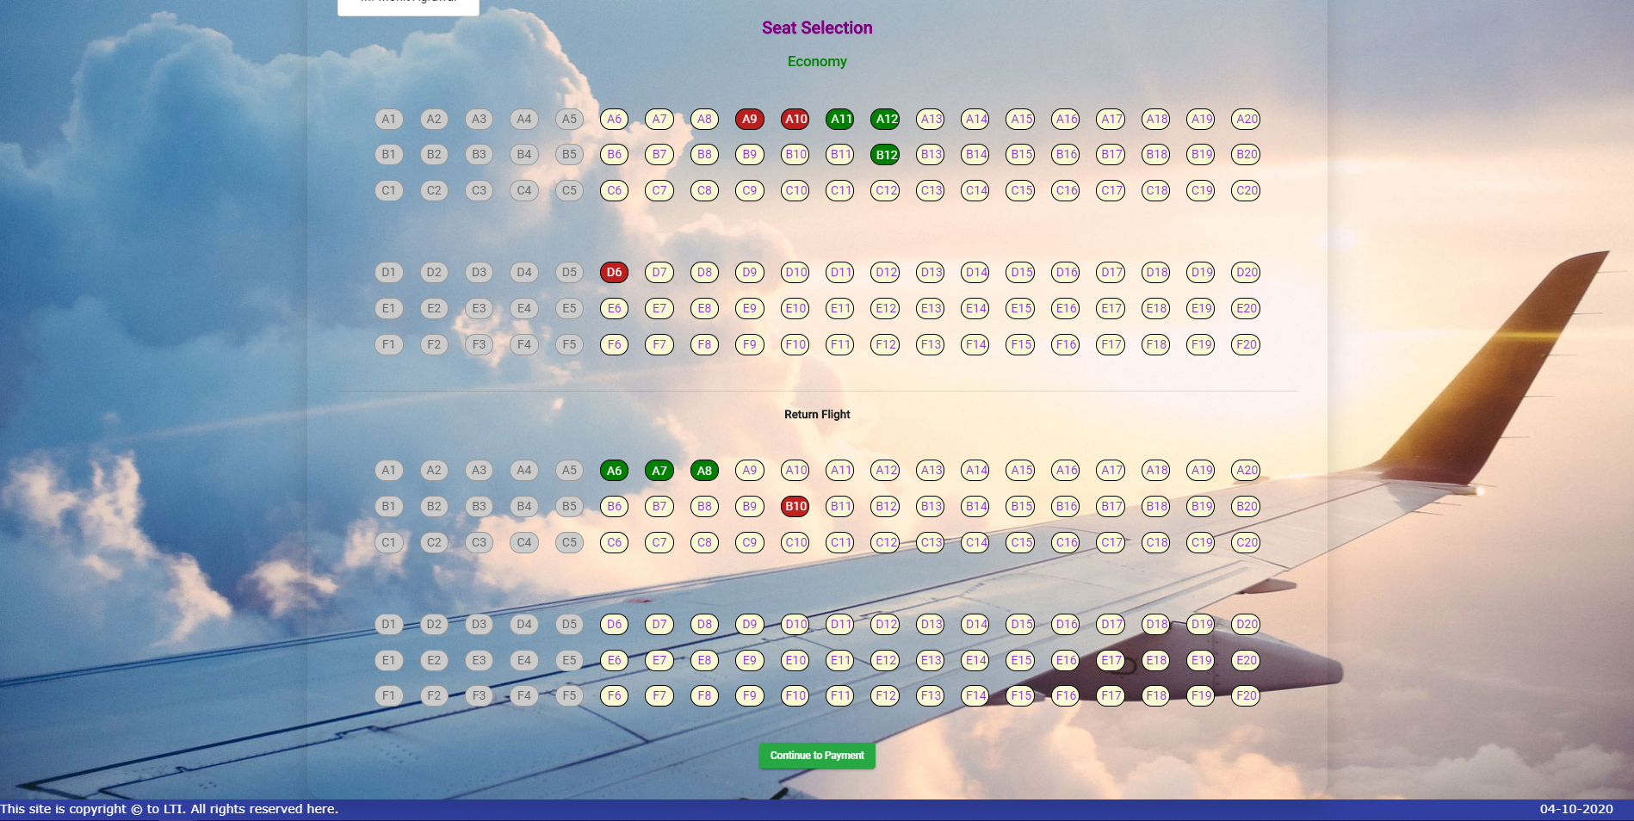
Select Seat

Slide 17
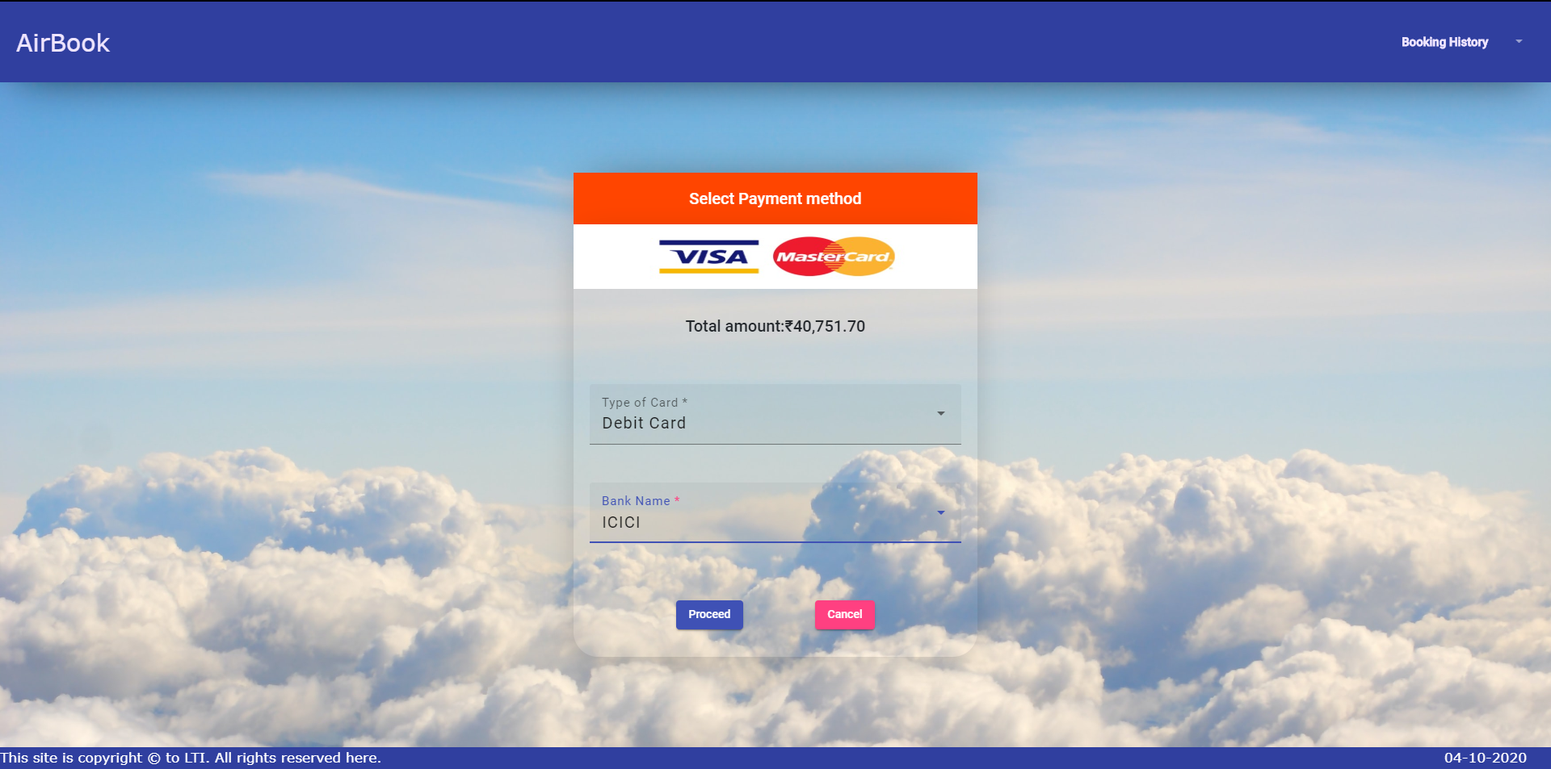
Select Mode of Payment and Bank

Slide 18
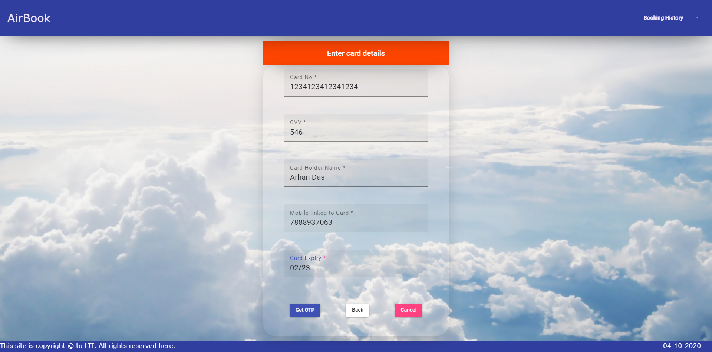
Enter Card Details

Slide 19
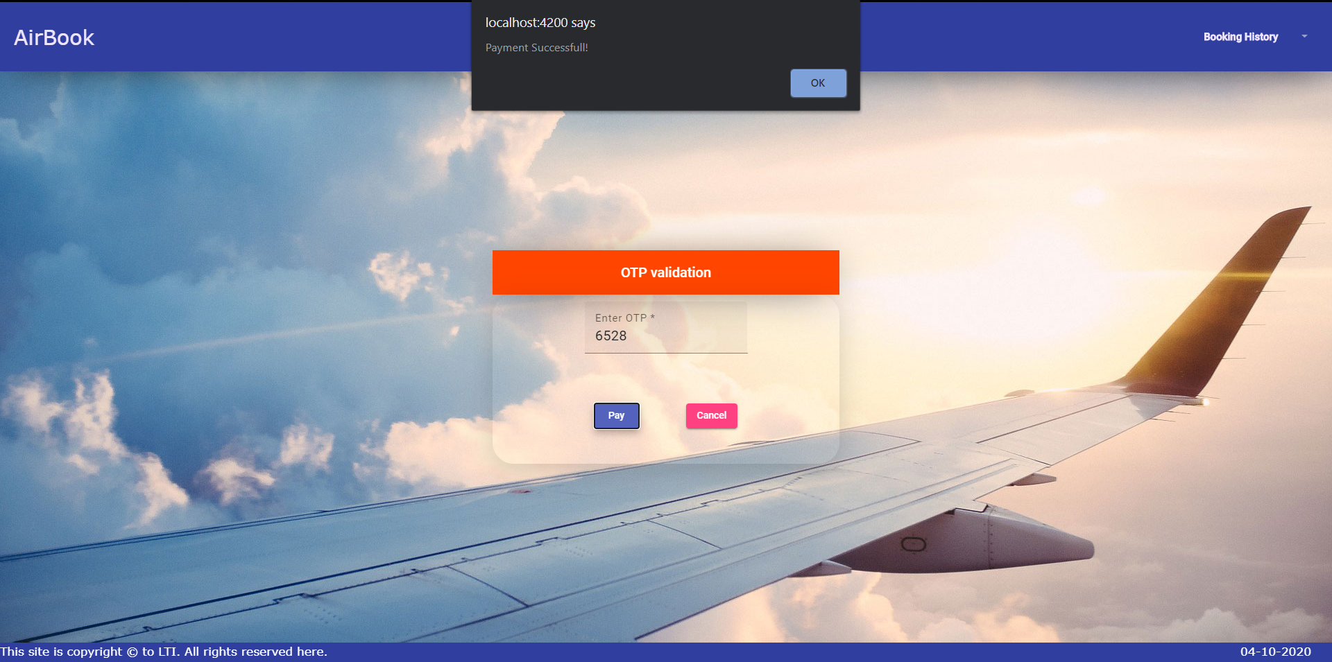
OTP Verification

Slide 20
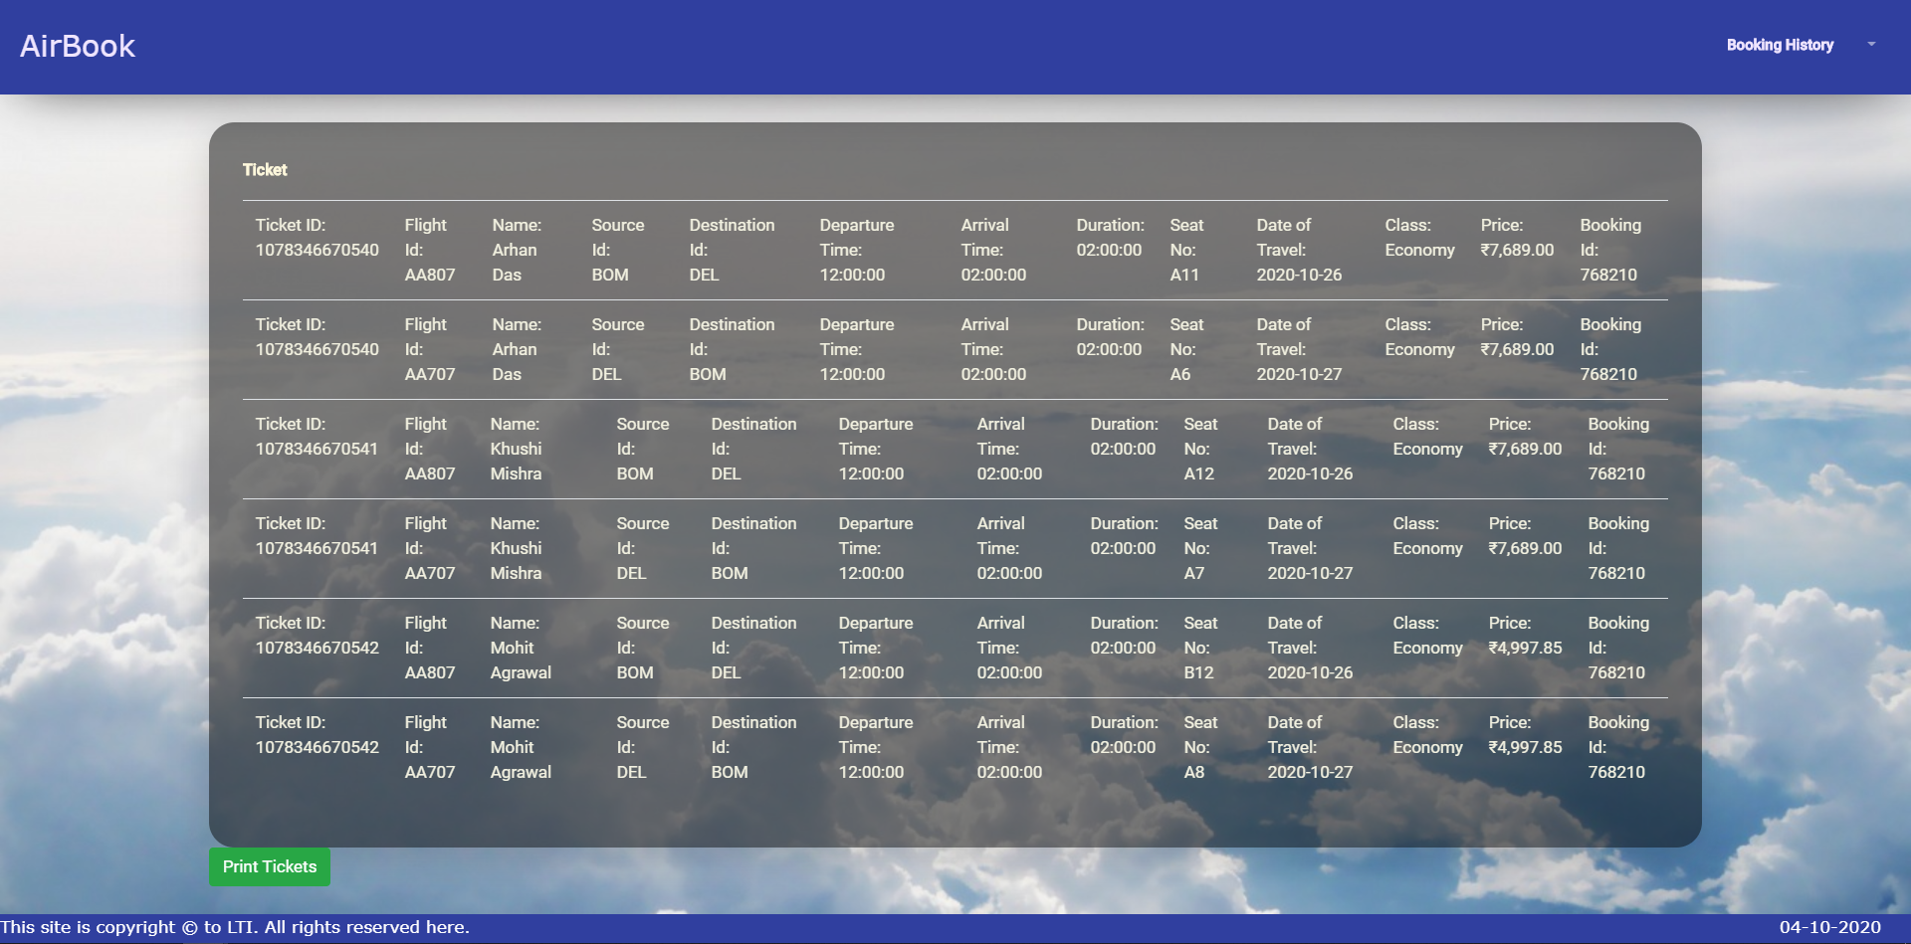
Show Ticket

Slide 21
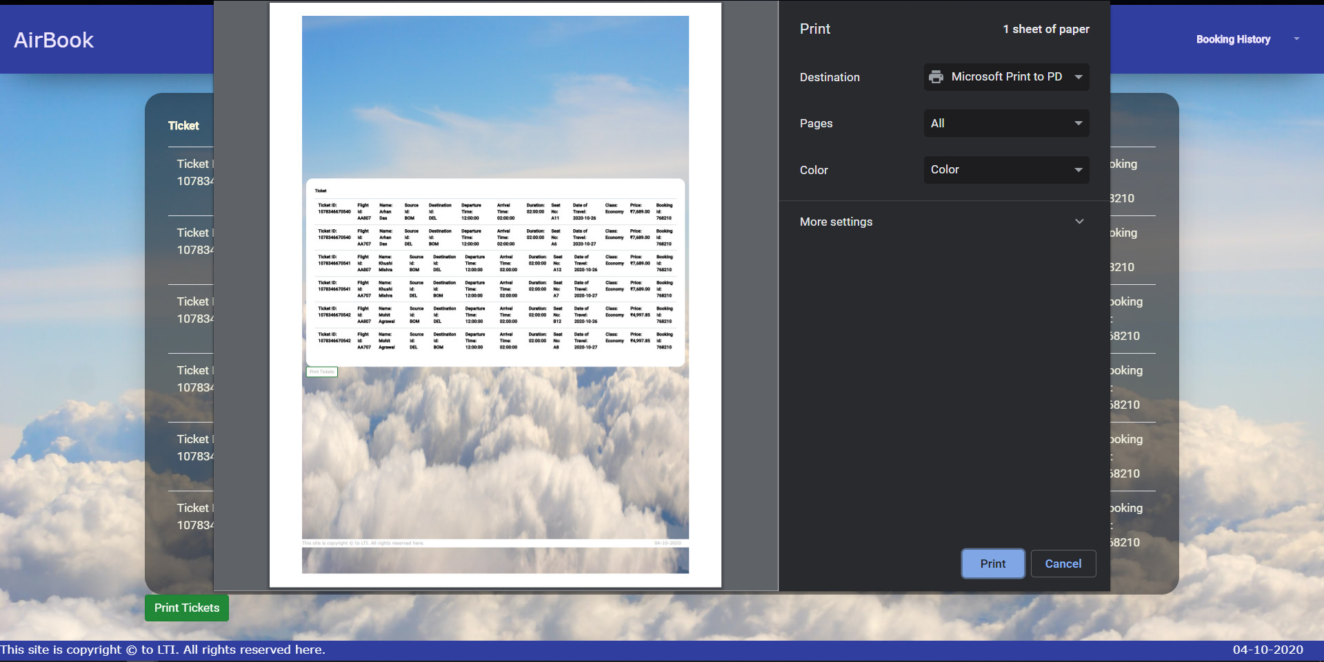
Print Ticket as pdf

Slide 22
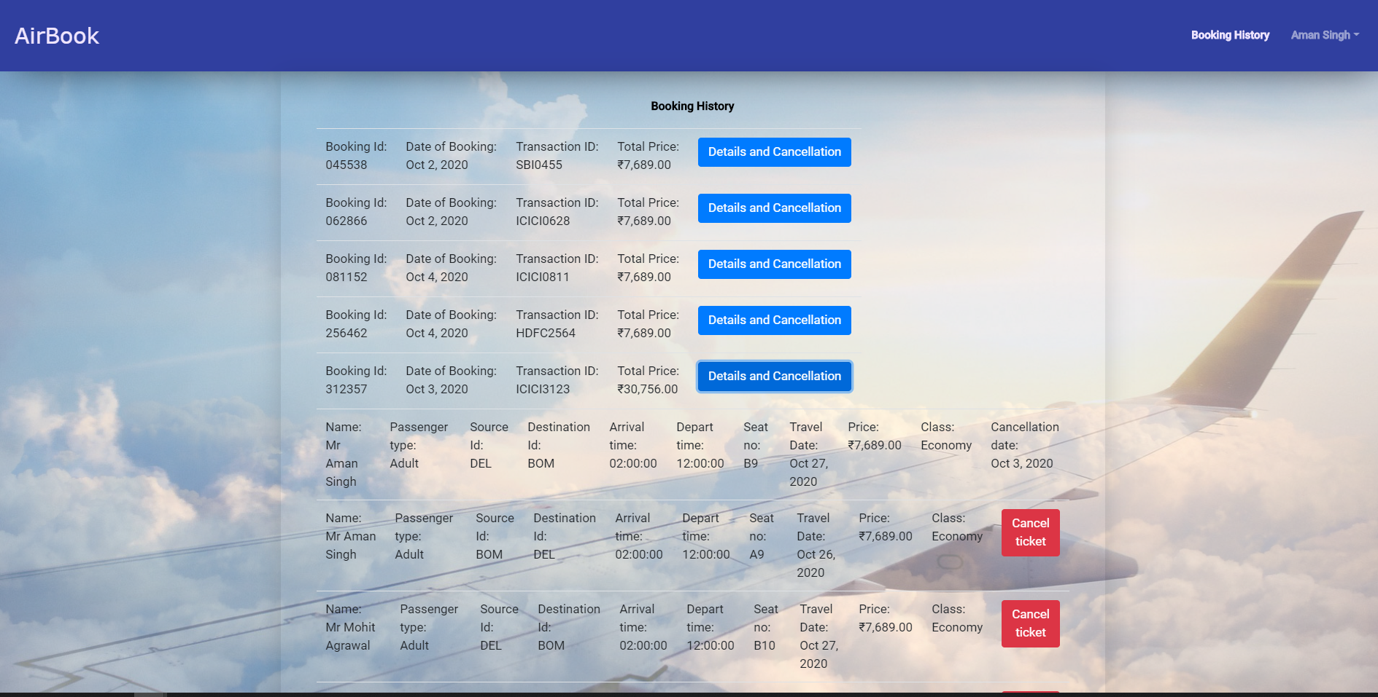
Booking History

Slide 23
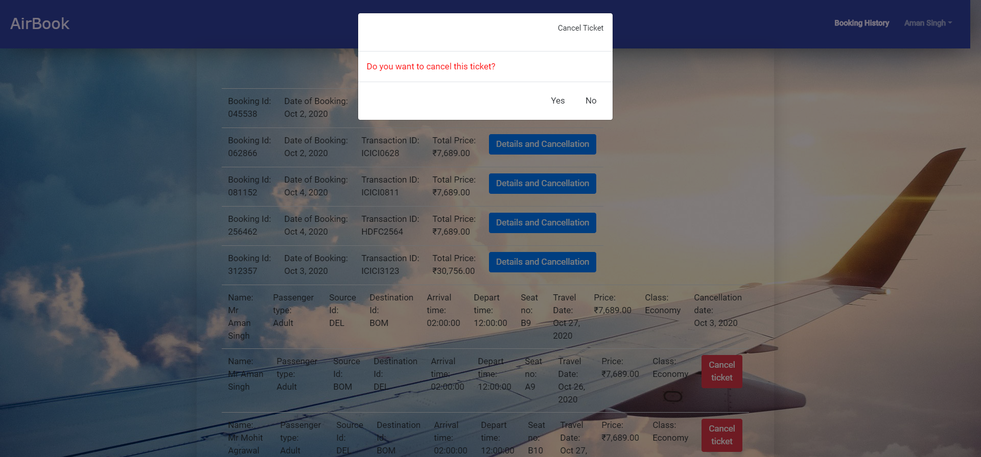
Confirmation before Cancelling ticket

Slide 24
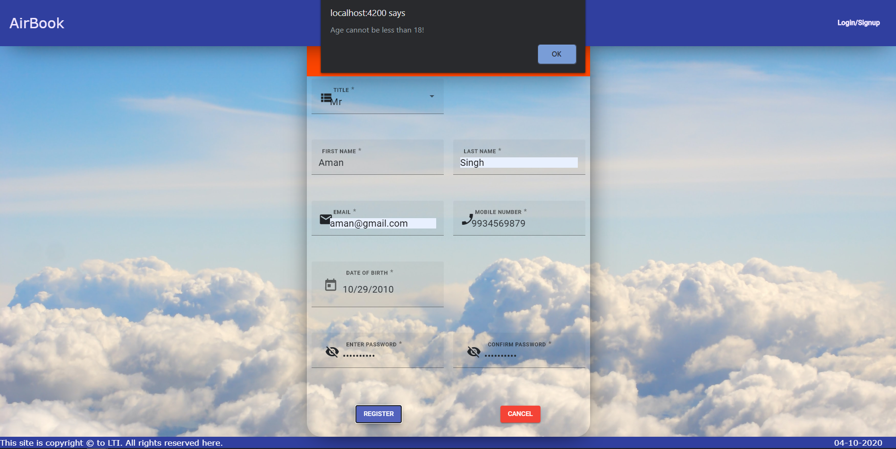
Age Restriction for new user

Slide 25
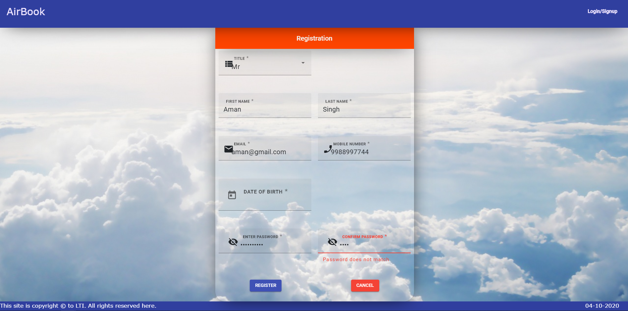
Confirm Password Validation

Slide 26
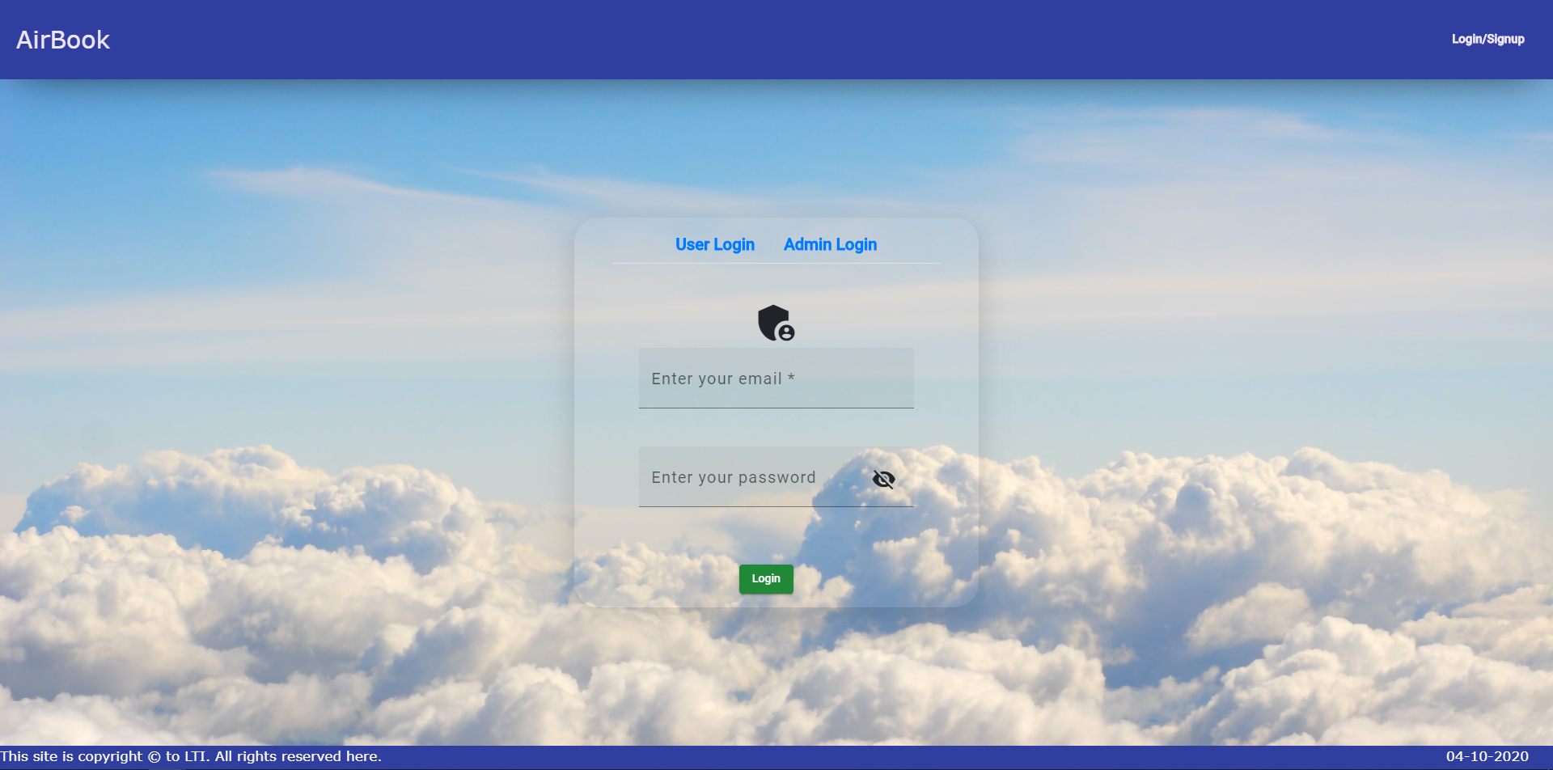
Admin Login

Slide 27
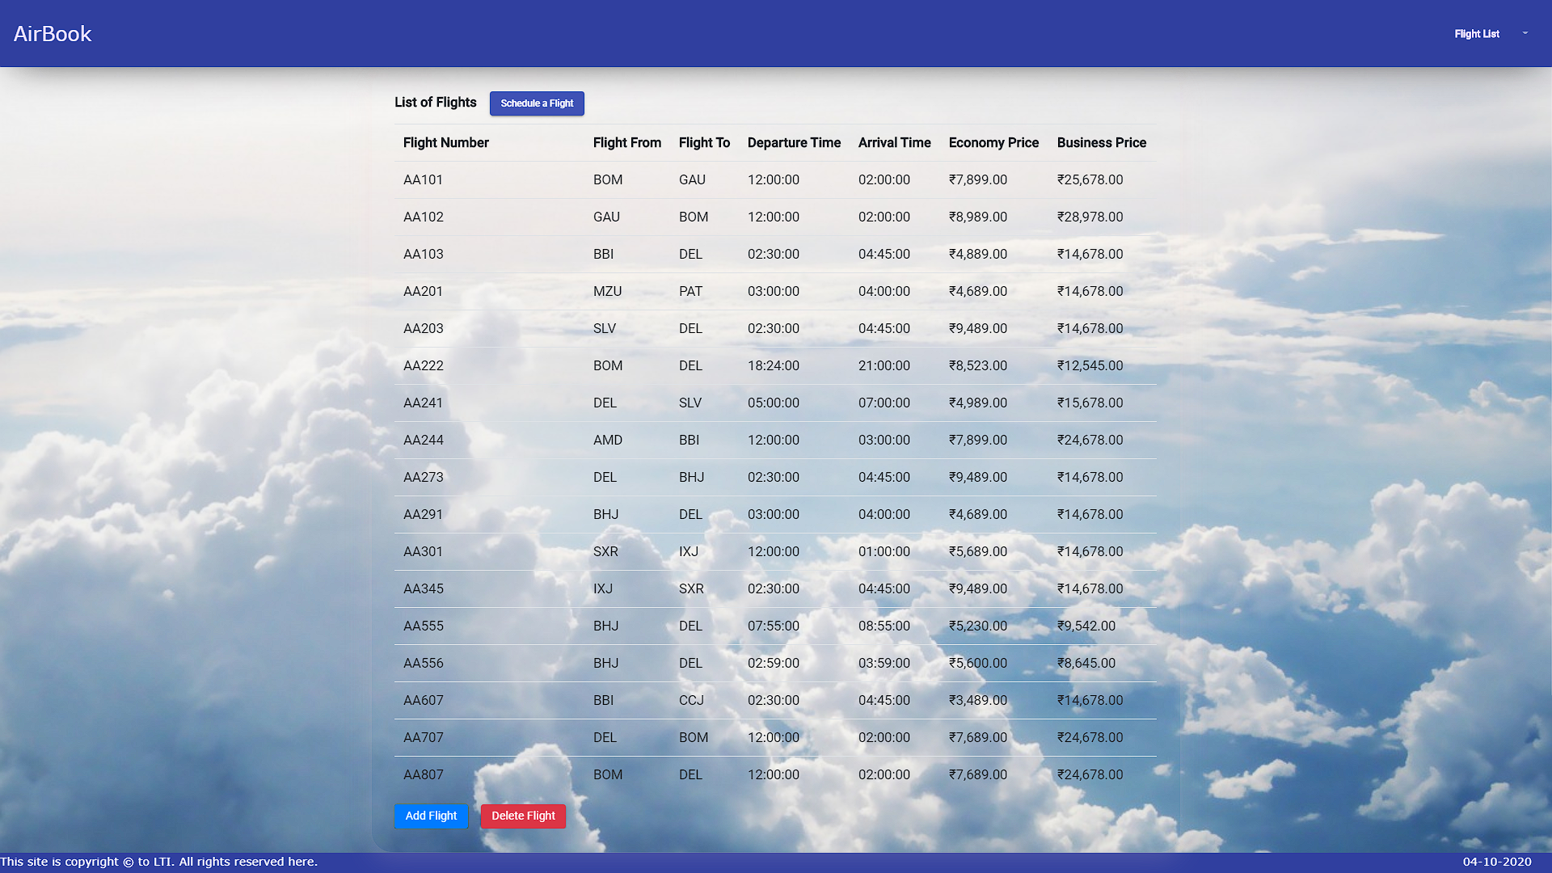
Flight List

Slide 28
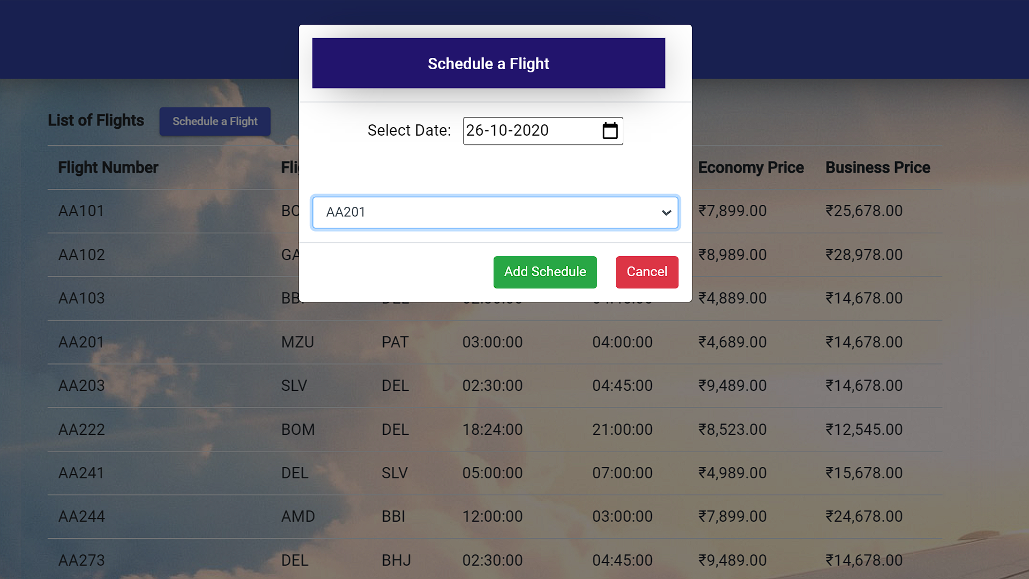
Schedule a Fligt

Slide 29
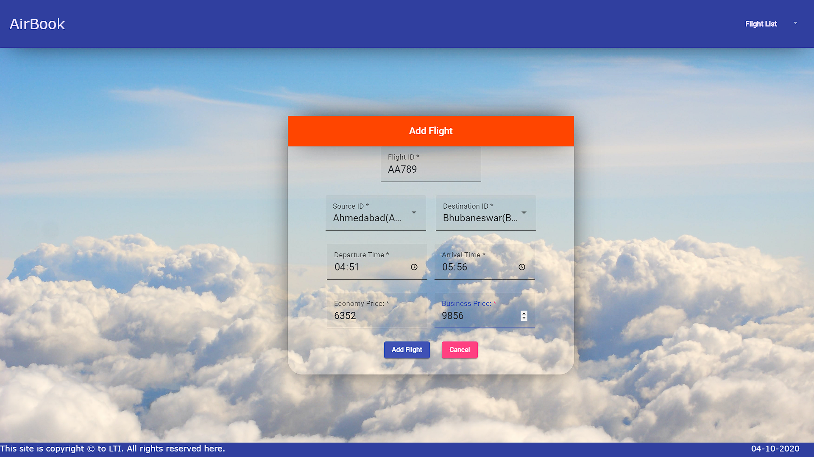
Add a New Flight

Slide 30
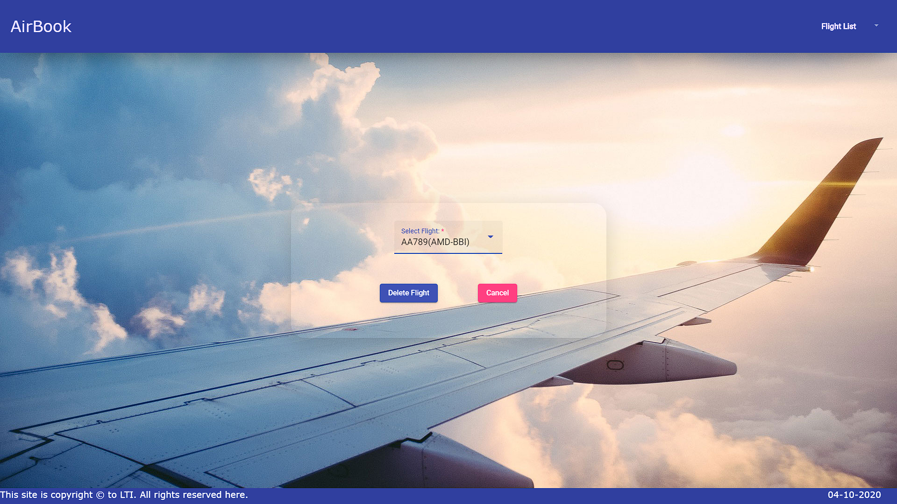
Delete Flight

